Slide 1
Optimizing Sleep
Staff Retreat Breakout Session II
Drew Weis, PhD, LP
Student Health and Counseling

Slide 2

How many of you have ever woke up an hour before your alarm and felt surprisingly refreshed?…

Slide 3

And when the alarm went off an hour or so later…

Slide 4

…you felt worse?

Slide 5

Waking at the end of a sleep cycle, we feel refreshed and alert…

Slide 6

Waking mid-sleep-cycle, we will feel less alert and less refreshed.

Slide 7
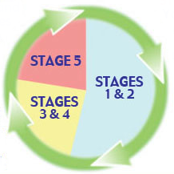
Why is that?
We sleep in cycles.
Waking at the end of a cycle is more refreshing than waking mid-cycle.
Five cycles is the optimal duration for most people.
Most cycles are 90-100 minutes long, but sleep cycles can range from 80-120 minutes long.
From our 20’s to mid- to late-40’s, sleep cycle durations remain fairly constant.
By age 50, sleep architecture starts to change.

Slide 8
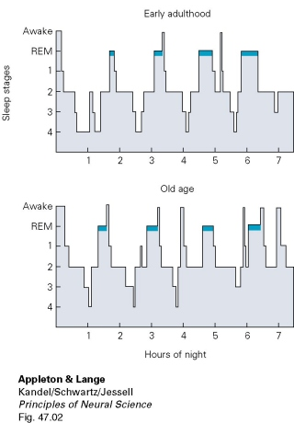
Sample
Sleep Cycles

Slide 9
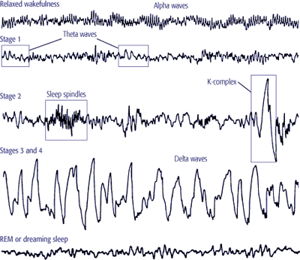
Sleep Stages
Awake…
Stage 1…
Stage 2…
Stages 3 and 4…
Stage 5 (REM)…

Slide 10

Optimizing Strategies
Create a sleep sanctuary
Establish helpful bedtime habits
Tame stress
Limit substances
Address health conditions and medications

Slide 11


Create a Sleep Sanctuary
Quiet
Dark
Uncluttered
Cool but not cold
Comfortable mattress
Pets?

Slide 12

Establish Bedtime Habits
Have regular bedtime and wake-up time
Know your exercise cut-off (typical recommendation is no fewer than 3-4 hours before bed)
Warm bath or shower about 30-60 min. before bed
Brush teeth early in evening, not right before bed
Avoid activities that are likely to ramp you up
(e.g., e-mails, Facebook, Twitter, arguments, online shopping, video games)

Slide 13

Tame Stress
10 minutes quiet time in the ½ hour before bed
  yoga, stretching or deep breathing
  meditation or prayer
  reading that calms or soothes (e.g., poetry, scripture)
  journal (e.g., free writing, worry list)
  autogenic training or progressive muscle relaxation
Daily exercise (a daily walk in nature is especially great for sleep)
If you nap to relax, keep it short, and get up and get outside at least 2 hours before sunset

Slide 14

Limit Substances
Caffeine stimulates the central nervous
system and inhibits fatigue signals
Nicotine stimulates the central nervous system and disrupts sleep due to withdrawal
Alcohol disrupts Stages 3, 4, and 5 (REM)
Marijuana disrupts REM sleep
Many prescription meds disrupt sleep as a side effect
Many sleep medications are not for long-term use and become less effective with prolonged use

Slide 15

Address Health Conditions
About 2/3 of chronic pain sufferers experience poor or unrefreshing sleep (NSF, 2003)
Anxiety compromises falling asleep &  nightmares
Depression compromises REM sleep and causes early waking (although early waking is not a reliable indicator of depression)
Night-time heart burn is a common sign of GERD (gastroesophogeal reflux disease)
Obesity significantly increases the risk for sleep apnea

Slide 16

for attending and for staying awake!
I’m happy to stay and respond to questions.
Feel free to call me x7993
or
e-mail me at dweis@carleton.edu

