Slide 1

Organic and Local - Why Does It Matter?
Mary Upham
Outreach and Education Coordinator

Slide 2
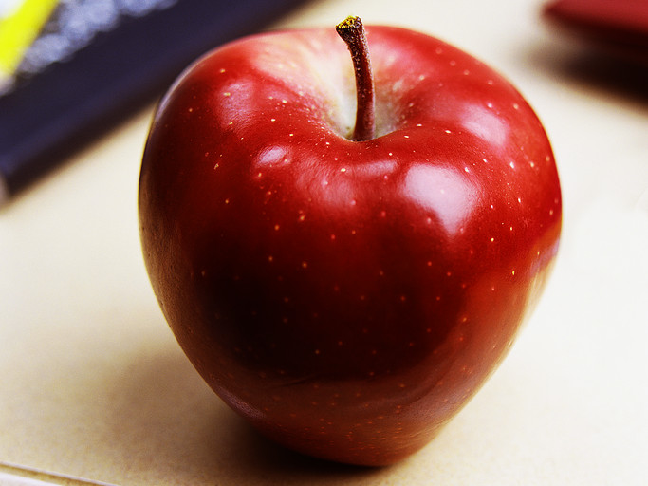
In a study in 2011, the USDA found…
over 40 pesticides in an average apple from the grocery store.

Slide 3
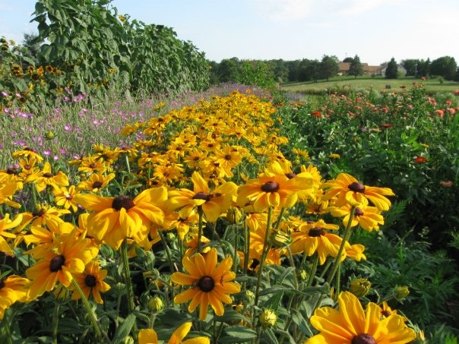
…an integrated farm that is itself a dynamic and organic whole…

Slide 4
USDA Organic Standards
Three years prior with no pesticides.
No use of synthetic fertilizers, pesticides, GMOs, sewage sludge, or irradiation.
Soil building, conservation, manure management, and crop rotation.
Outdoor access and pasture for livestock.
No antibiotics or hormones used.
100% organic feed.
Keep records of all operations.
Inspected annually by an accredited Organic Certifier.

Slide 5
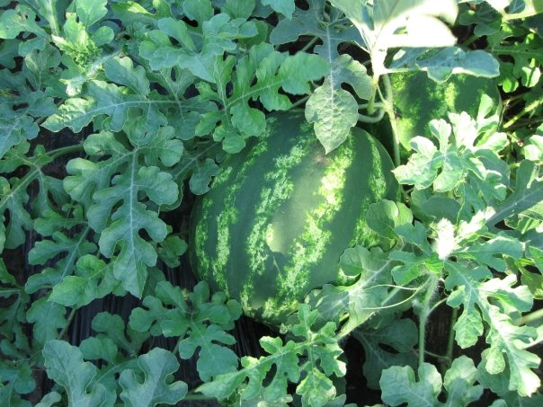
What does local food mean?

Slide 6
US
Our region
Your garden
Our town

Slide 7
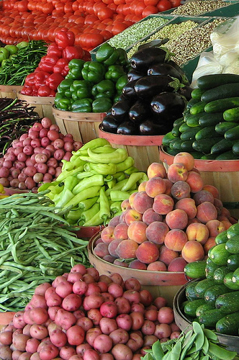
What is local to you?

Slide 8
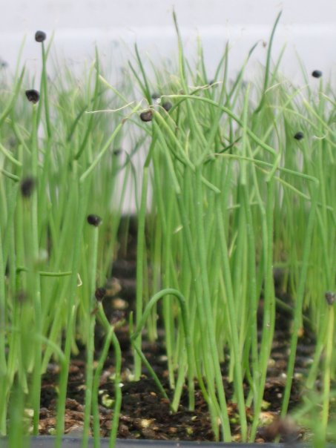
What is available locally?

Slide 9
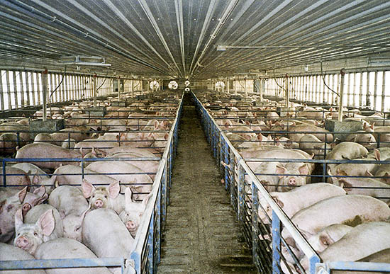
Is it sustainable?

Slide 10

Sustainable Farming
Healthy food production methods
Does not harm environment
Respects workers
Humane to animals
Provides fair wages to farmers
Supports farming community

Slide 11
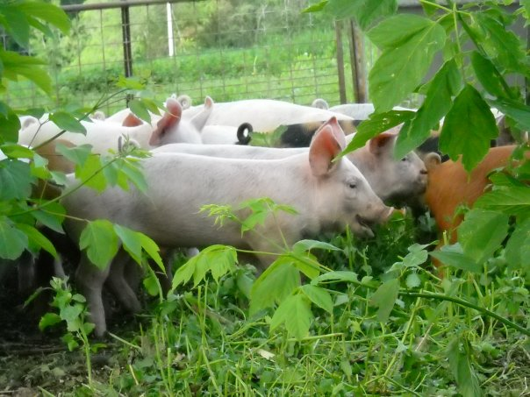
Organic, local, sustainable…. why does it matter?

Slide 12
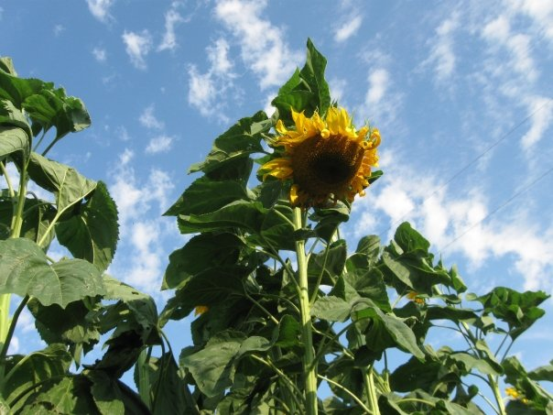
Environment, health, local economy, and flavor!

Slide 13
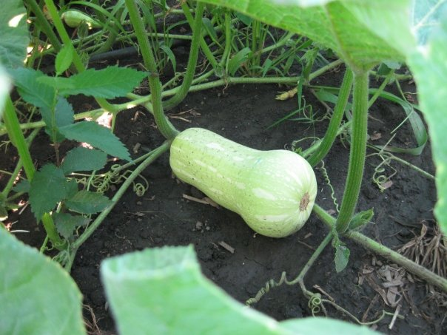
Local organic food has a lighter impact on the environment.

Slide 14
Feed the Soil
Feed the Plant
Soil fertility is a biological process
Only the nutrients removed from the farm as crops need to be replaced
Soil fertility is an imported commodity
All nutrients required to “create” a crop are purchased from off the farm

Slide 15
Feed the Soil
Feed the Plant
Nitrogen is not purchased because it is supplied by symbiotic and non-symbiotic processes
Inputs are purchased in their least processed and least expensive form
Sustainable
Nitrogen is a very important purchased input
Inputs are purchased in their most processed and expensive form and performed on an industrial level
Non-sustainable

Slide 16
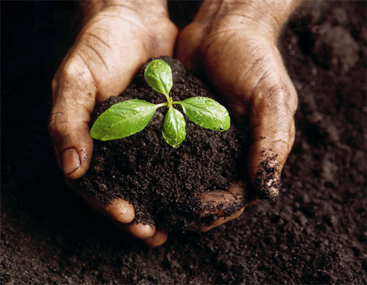
Healthy, vibrant soil is full of life.

Slide 17
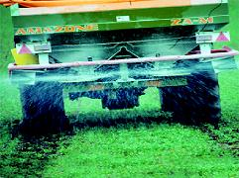
As much as forty percent of the energy used in the food system goes into the production of chemical fertilizers and pesticides.

Slide 18

What if….?
Iowa sustainably grew 10% more food just for local consumption?
Save 300 thousand gallons of fuel
Reduce CO2 emissions by 7 million pounds

Slide 19
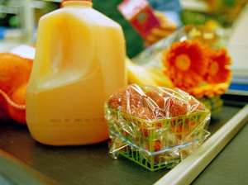
Packaging contributes to the waste

Slide 20
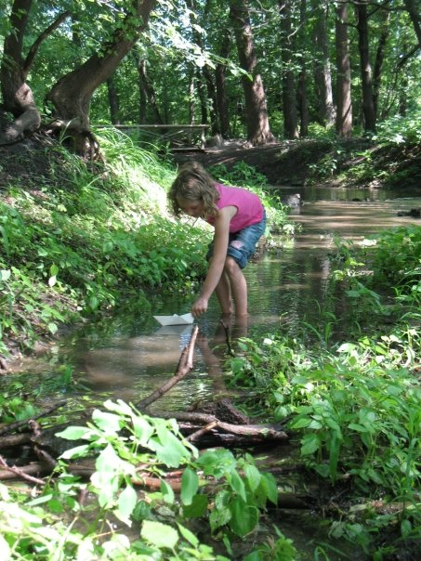
Hazards of industrial farming
Agricultural runoff pollutes our lakes, rivers, and groundwater.
21 out of 23 lakes in Rice County are unsafe for swimming.

Slide 21
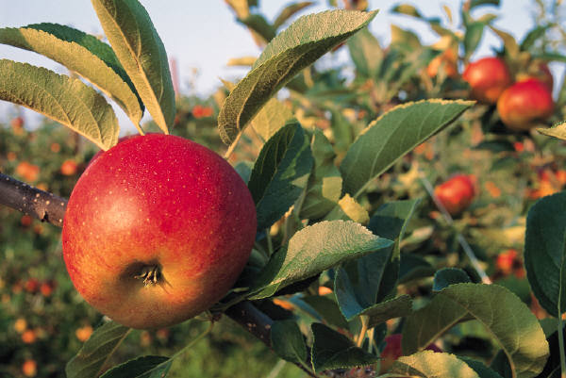
What is the difference?

Slide 22
President's Cancer Panel Report, May 2010
“Exposure to pesticides can be decreased by choosing, to the extent possible, food grown without pesticides or chemical fertilizers... Similarly, exposure to antibiotics, growth hormones, and toxic run-off from livestock feed lots can be minimized by eating free-range meat raised without these medications.”

Slide 23
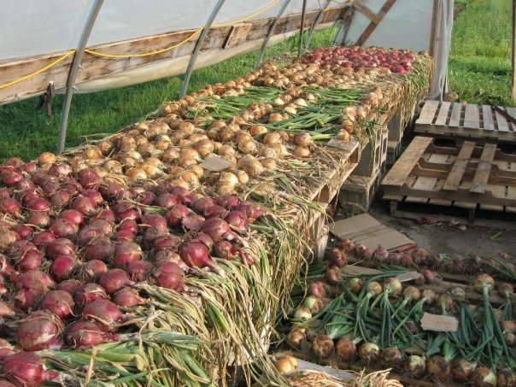
Organic production and processing is the only system that uses certification and inspection to verify that these chemicals are not used on the farm all the way to our dinner tables.

Slide 24

Ample organic fruits, veggies, grains, and dairy for a child:
Promote healthy patterns of cell division, normal endocrine system
Helps establish healthy taste preferences
Can eliminate dietary exposures to as many as 180 pesticides

Slide 25
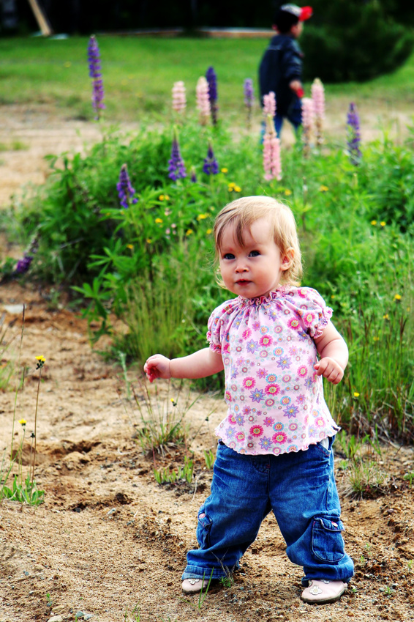
Children eating mostly organic produce have pesticide levels 6-9 times lower.

Slide 26

During adolescence and adulthood organic food:
Helps trigger the feeling of fullness
Lessens or limits damage done by free radicals
Slows or even reverses the aging process with regard to memory

Slide 27
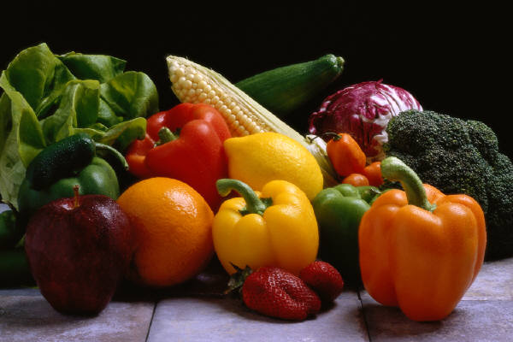
The Dirty Dozen
Peaches
Apples
Bell pepper
Celery
Nectarines
Strawberries
Cherries
Kale
Lettuce
Grapes (imported)
Carrots
Pears

Slide 28
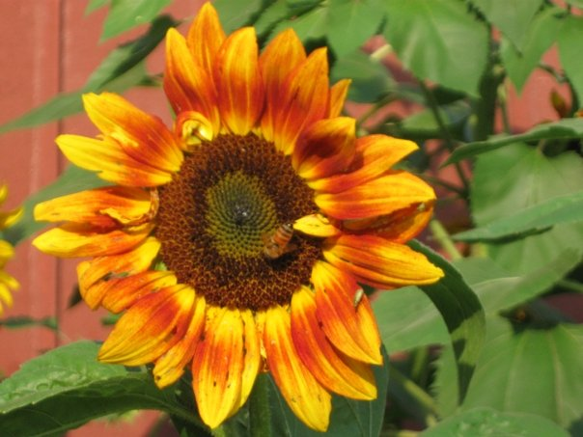
Fewer chemicals in the air, earth, and water is less risky.

Slide 29
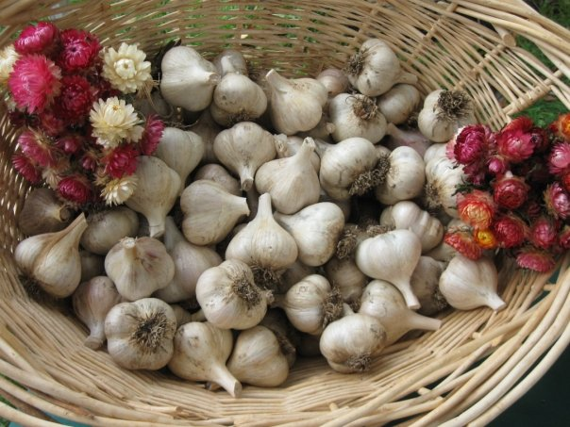
Flavor!

Slide 30
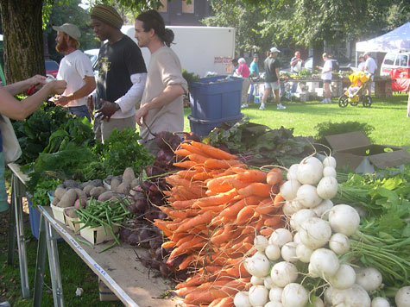
There are many reasons for buying local food.

Slide 31
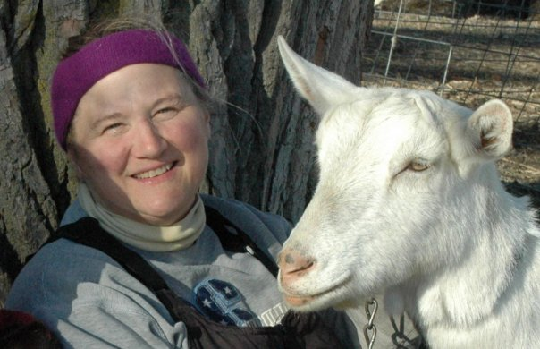
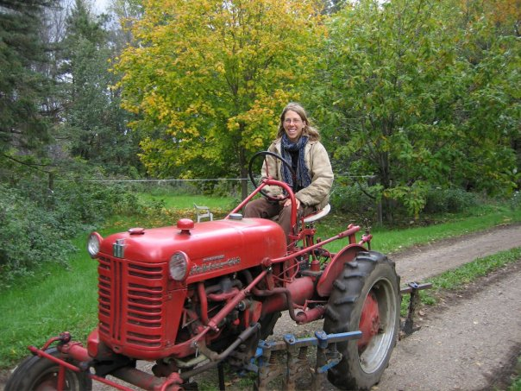
Get to know your local farmers

Slide 32
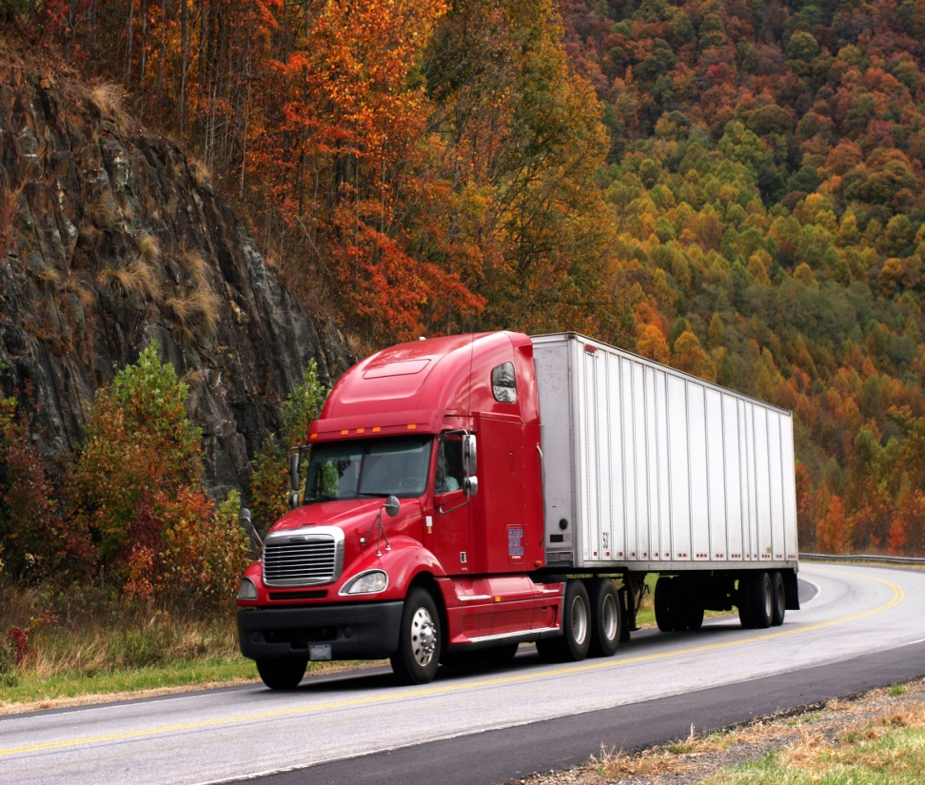
What are “food miles”?
Food miles are the distance food travels from the farm to your home.
Grocery store produce averages about 1500 miles.
40% of our fruit comes from overseas.
9% of red meat in grocery stores comes from as far away as New Zealand.

Slide 33
What are the economics?
Now
1910
7% of the local food dollars stay in the community
93% of modern food dollars goes to process, package, and transport the goods
40% of food dollars remained in the local economy
More money staying in the community means thriving main streets and local jobs

Slide 34
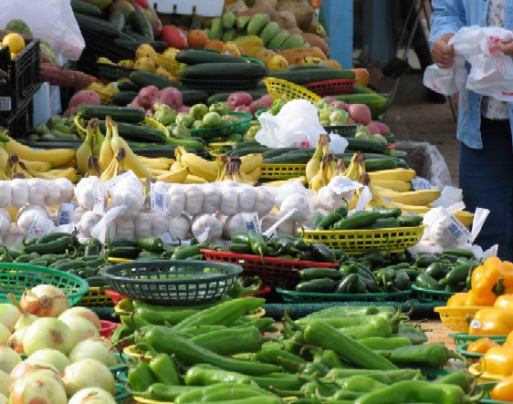
Buying directly from farmers can dramatically increase their income.

Slide 35
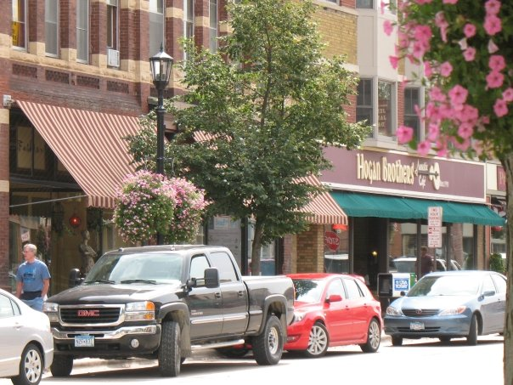
Buying from local farmers translates to a thriving local economy.

Slide 36
What are the barriers?
Availability
Cost
Farmer’s Market
Community Supported Agriculture share (CSA)
Direct from the farmer
Just Food Co-op
Shop seasonally
Quality instead of quantity
Invest in the future
How to Shop Co-op on a Budget class

Slide 37
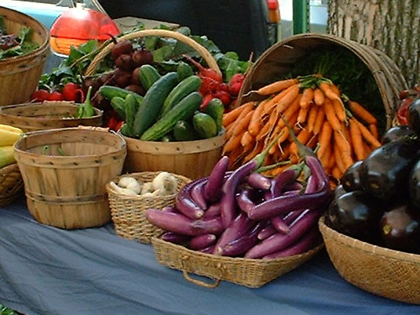
Organic, local, and sustainable farming benefits the local community.

Slide 38
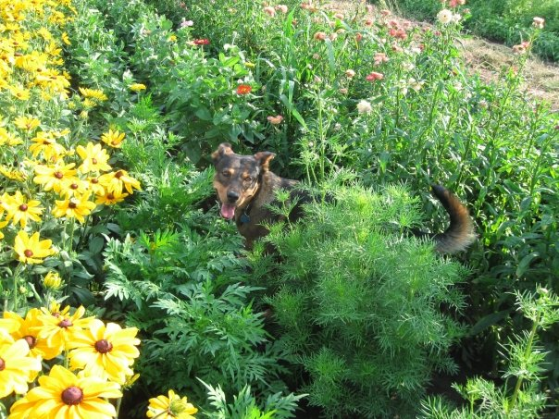
Sustainable farmers are good stewards of the land.

Slide 39
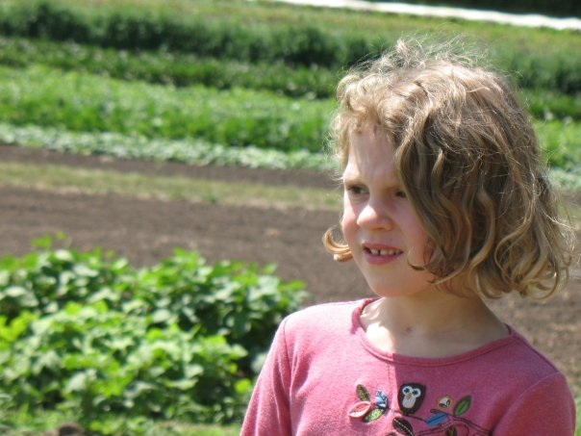
You can help reduce the
environmental impact on future generations.

Slide 40
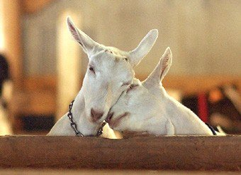
Thanks to Kathy Zeman of Simple Harvest Farm Organics, Ben Doherty and Erin Johnson of
Open Hands Farm, and the Upham girls for permission to use their photos

